Slide 1
BIP The Robots Intellect: Balancing Robot
Team 3: StableBot Squad

Slide 2
THE ROBOT

Slide 3
Online development process
Week 2: Type of the robot has been picked to be two wheeled.A draft of it has been made.The motor type was chosen to be a stepper motor and a 3 axis gyroscope and accelerometer for the angular sensor.
Week 3: Exact type of the motor and the sensor was decided to be FIT0278 stepper motor and MPU6050 gyro sensor.The draft of the wheels has been added to the robot.The electric circuit draft has been completed.
Week 4: The work on the wheels and the circuit has been continued, incorporating some changes into the wheel and circuit designs.

Slide 4
Online development process
Week 5: The design of the robot has been changed.The Bill of Materials has been completed.Some starting steps to making a PCB design have been done.
Week 6:More details have been added to the robot’s draft,most notably the casing.The first design of the PCB has been completed.
Week 7: The PCB and the microcontroller programm have been compelted.

Slide 5
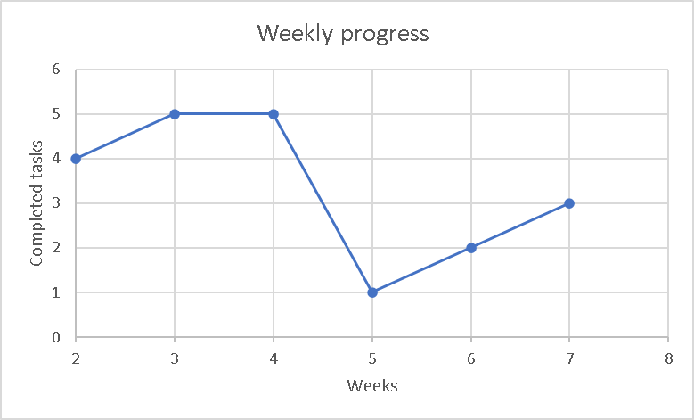
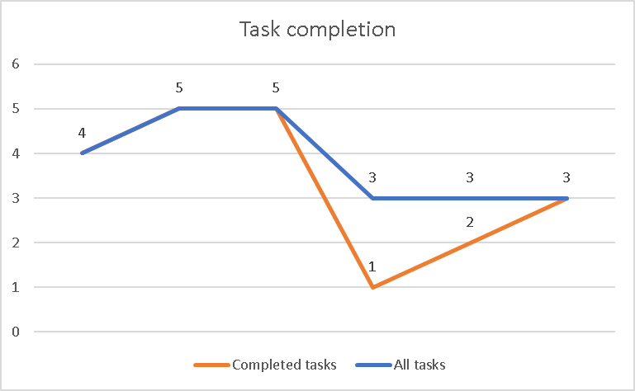
Weekly progress

Slide 6
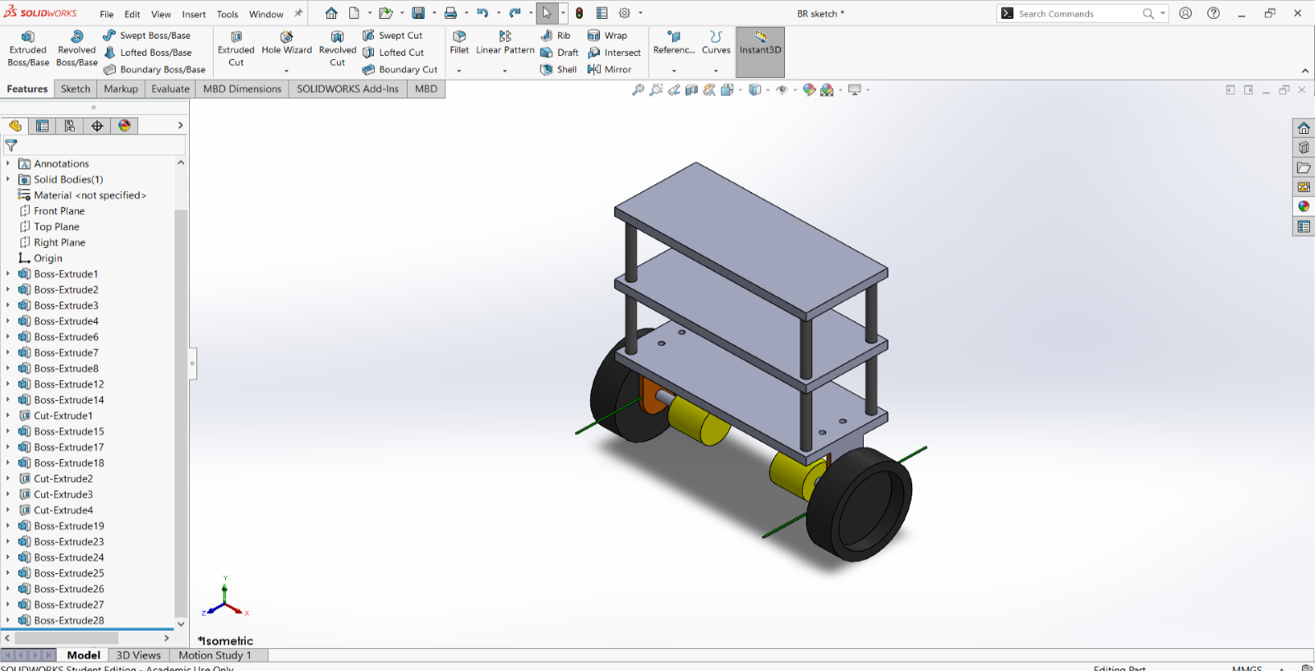
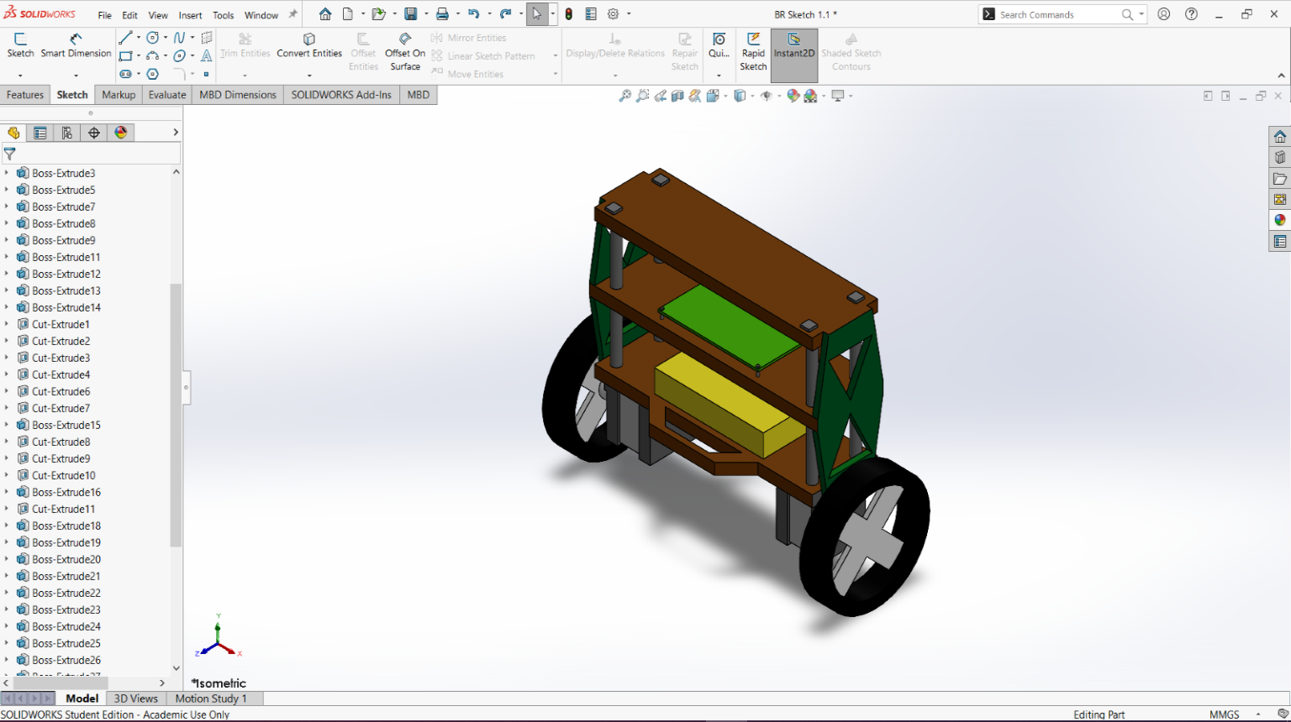
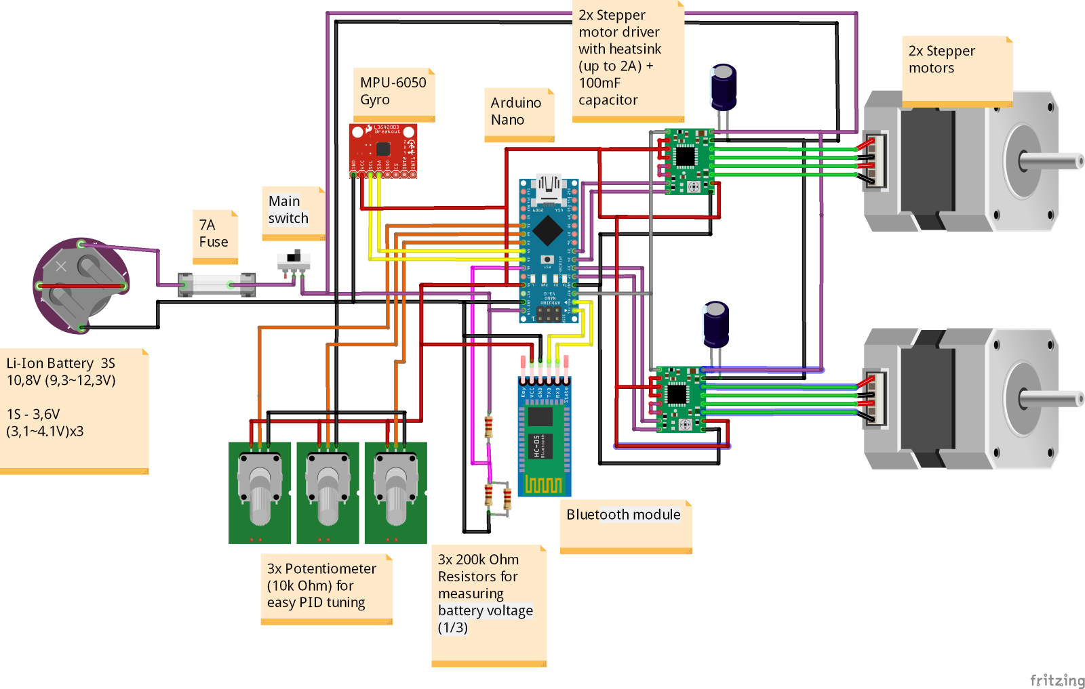
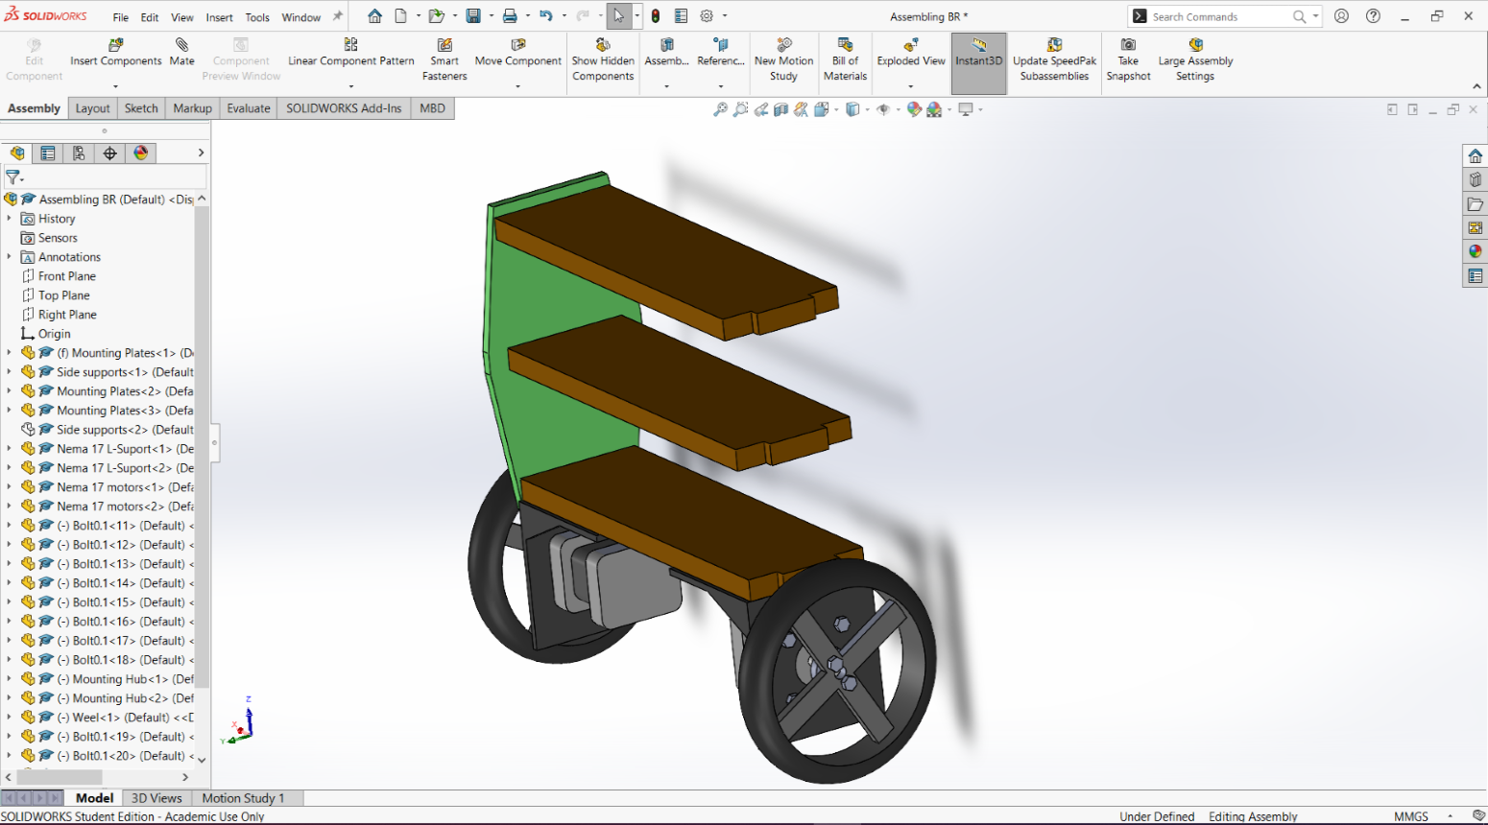
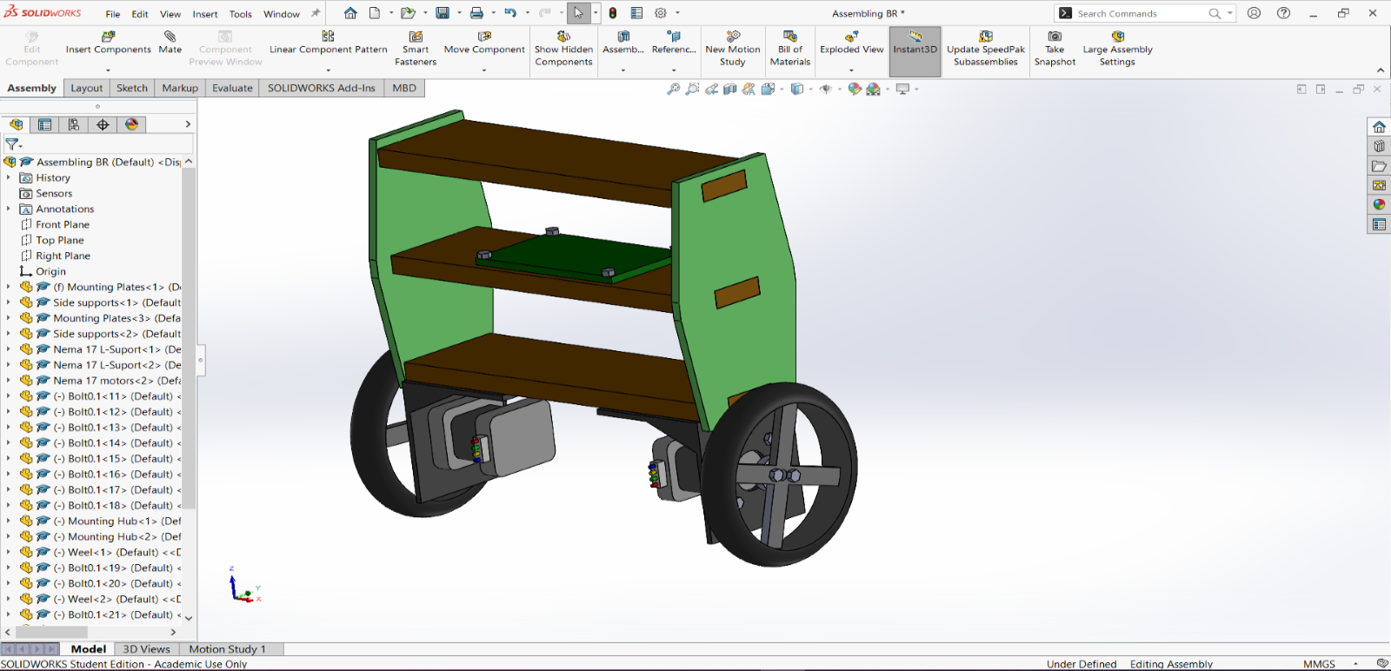
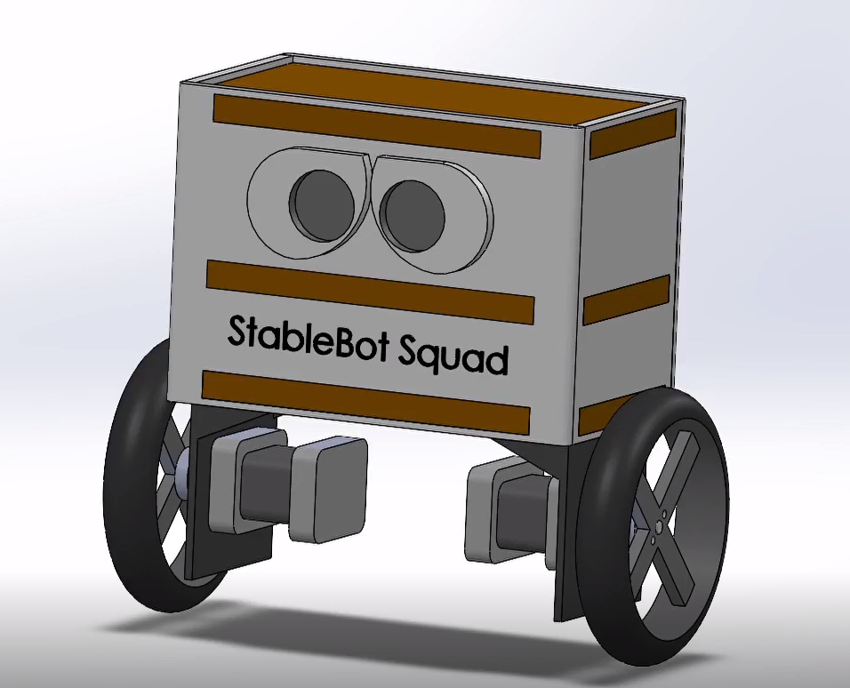

Slide 7
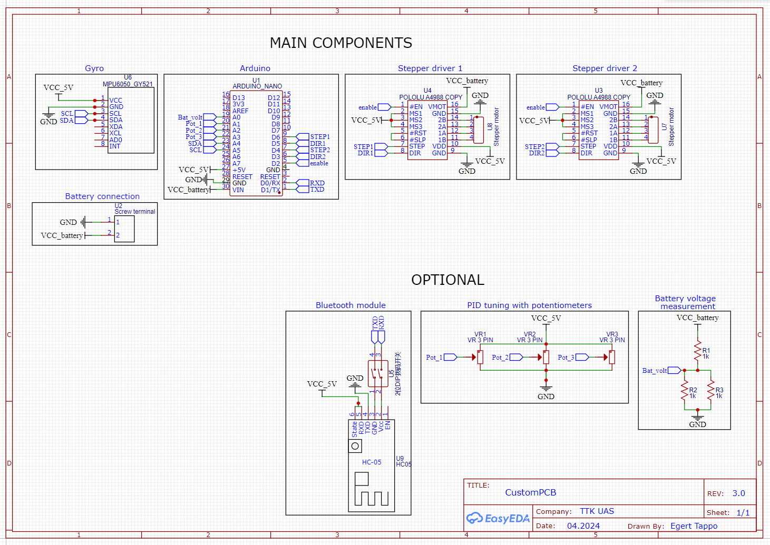

Slide 8
Physical development process
Day 1
We picked out the needed components for the robot.Prepared the 3D printed parts and assembled the structure.The first PCB cutout wasn’t fit for use because of the mistakes made while cutting it out and it’s design including some unnecesarry parts, so the PCB design has been remade.

Slide 9
Physical development process
Day 2
The assembling of the robot has been continued:wheels , two motors , battery basket and a switch have been added.With that, we prepared the electrical components to test the microcontroller programm.The program did work and the motors responded to it, but not exactly in the intended way.The new PCB has been made according to the updated design and all the necessary components got soldered to it.

Slide 10
Physical development process
Day 3
Due to the inconvenience of the PCB, we decided to use a breadboard instead.We continued testing the program, tried different approaches, which unfortunately wasn’t succesfull.

Slide 11
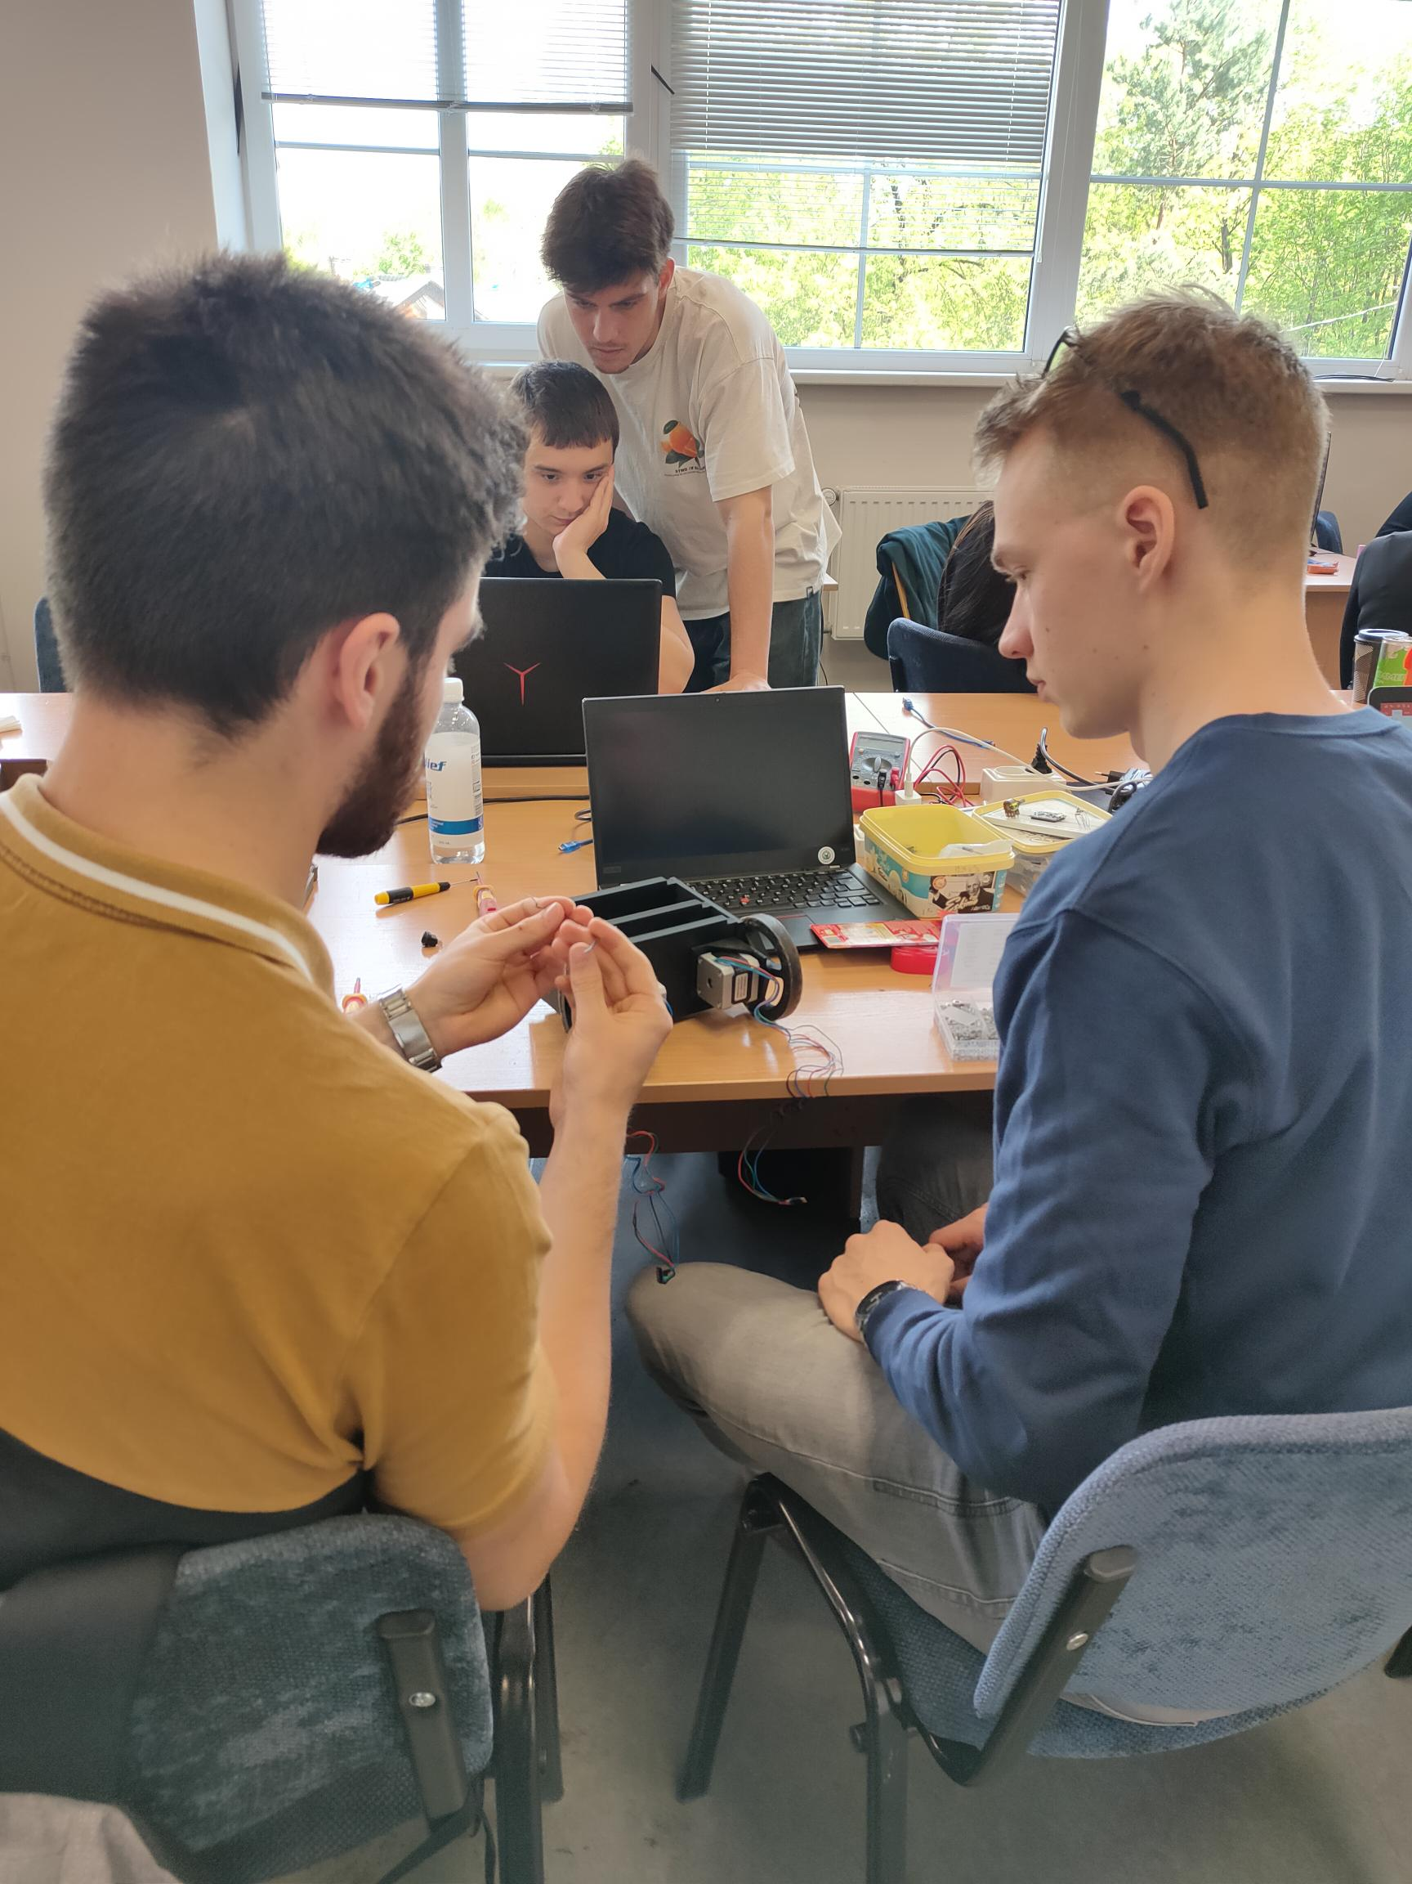
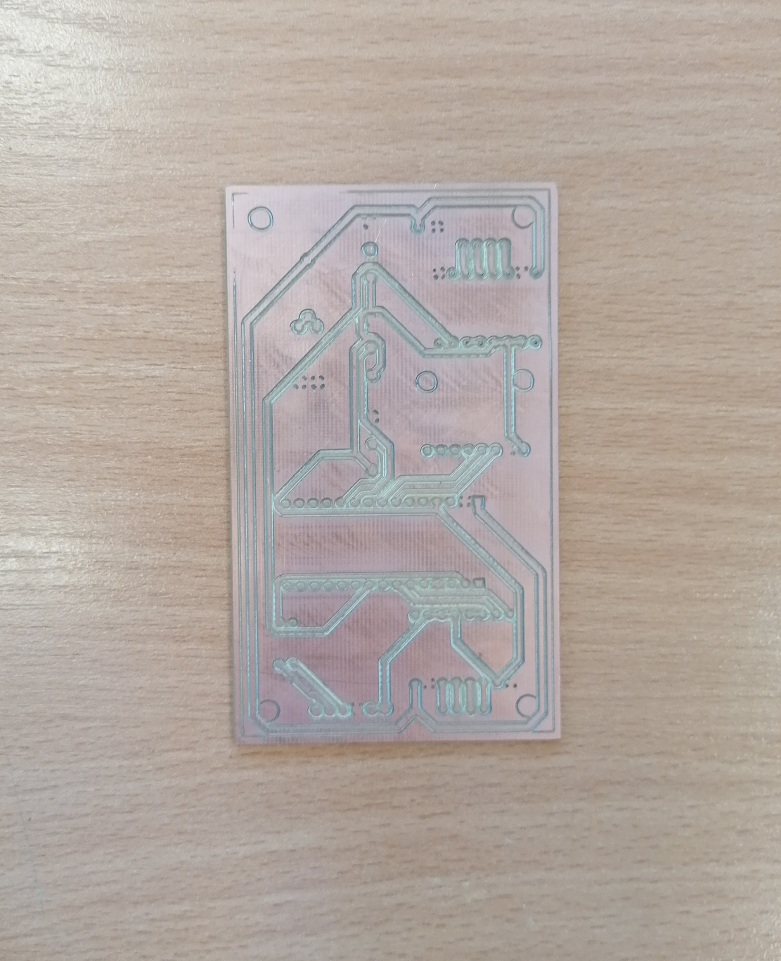
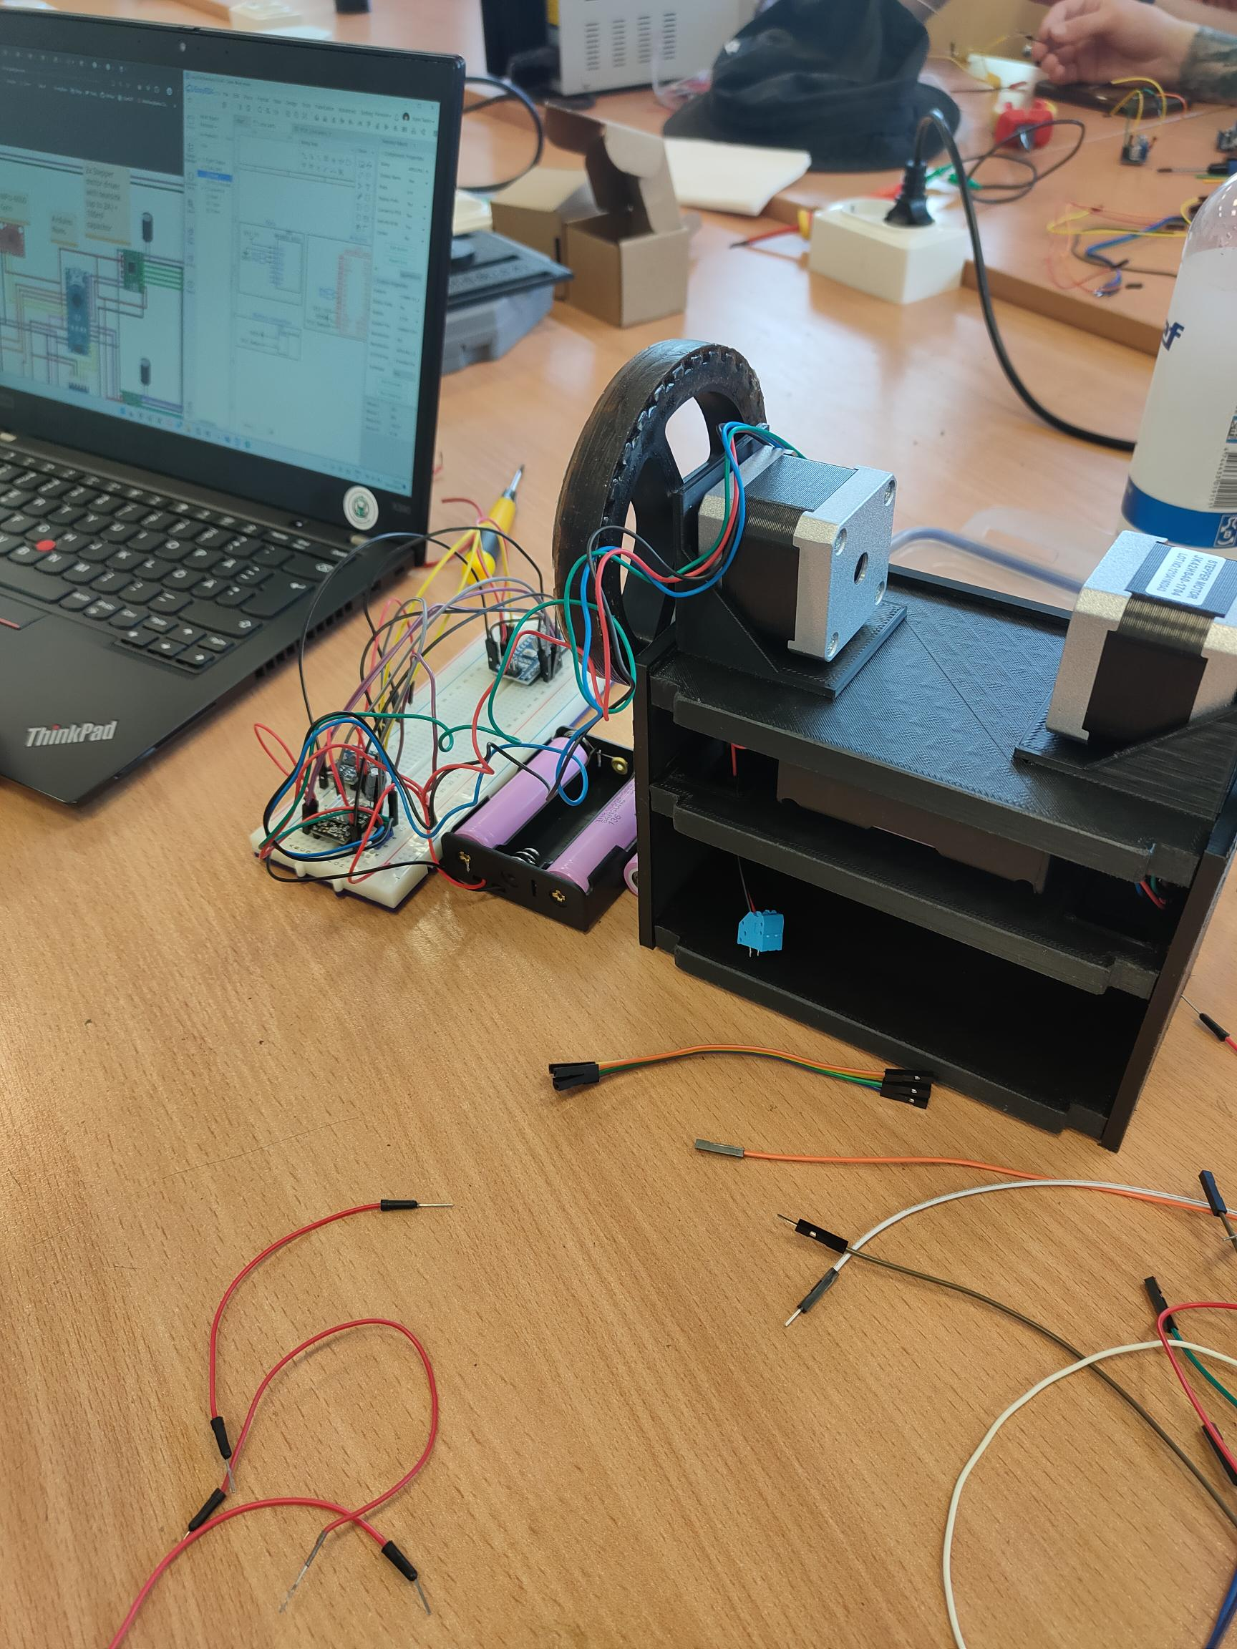

Slide 12
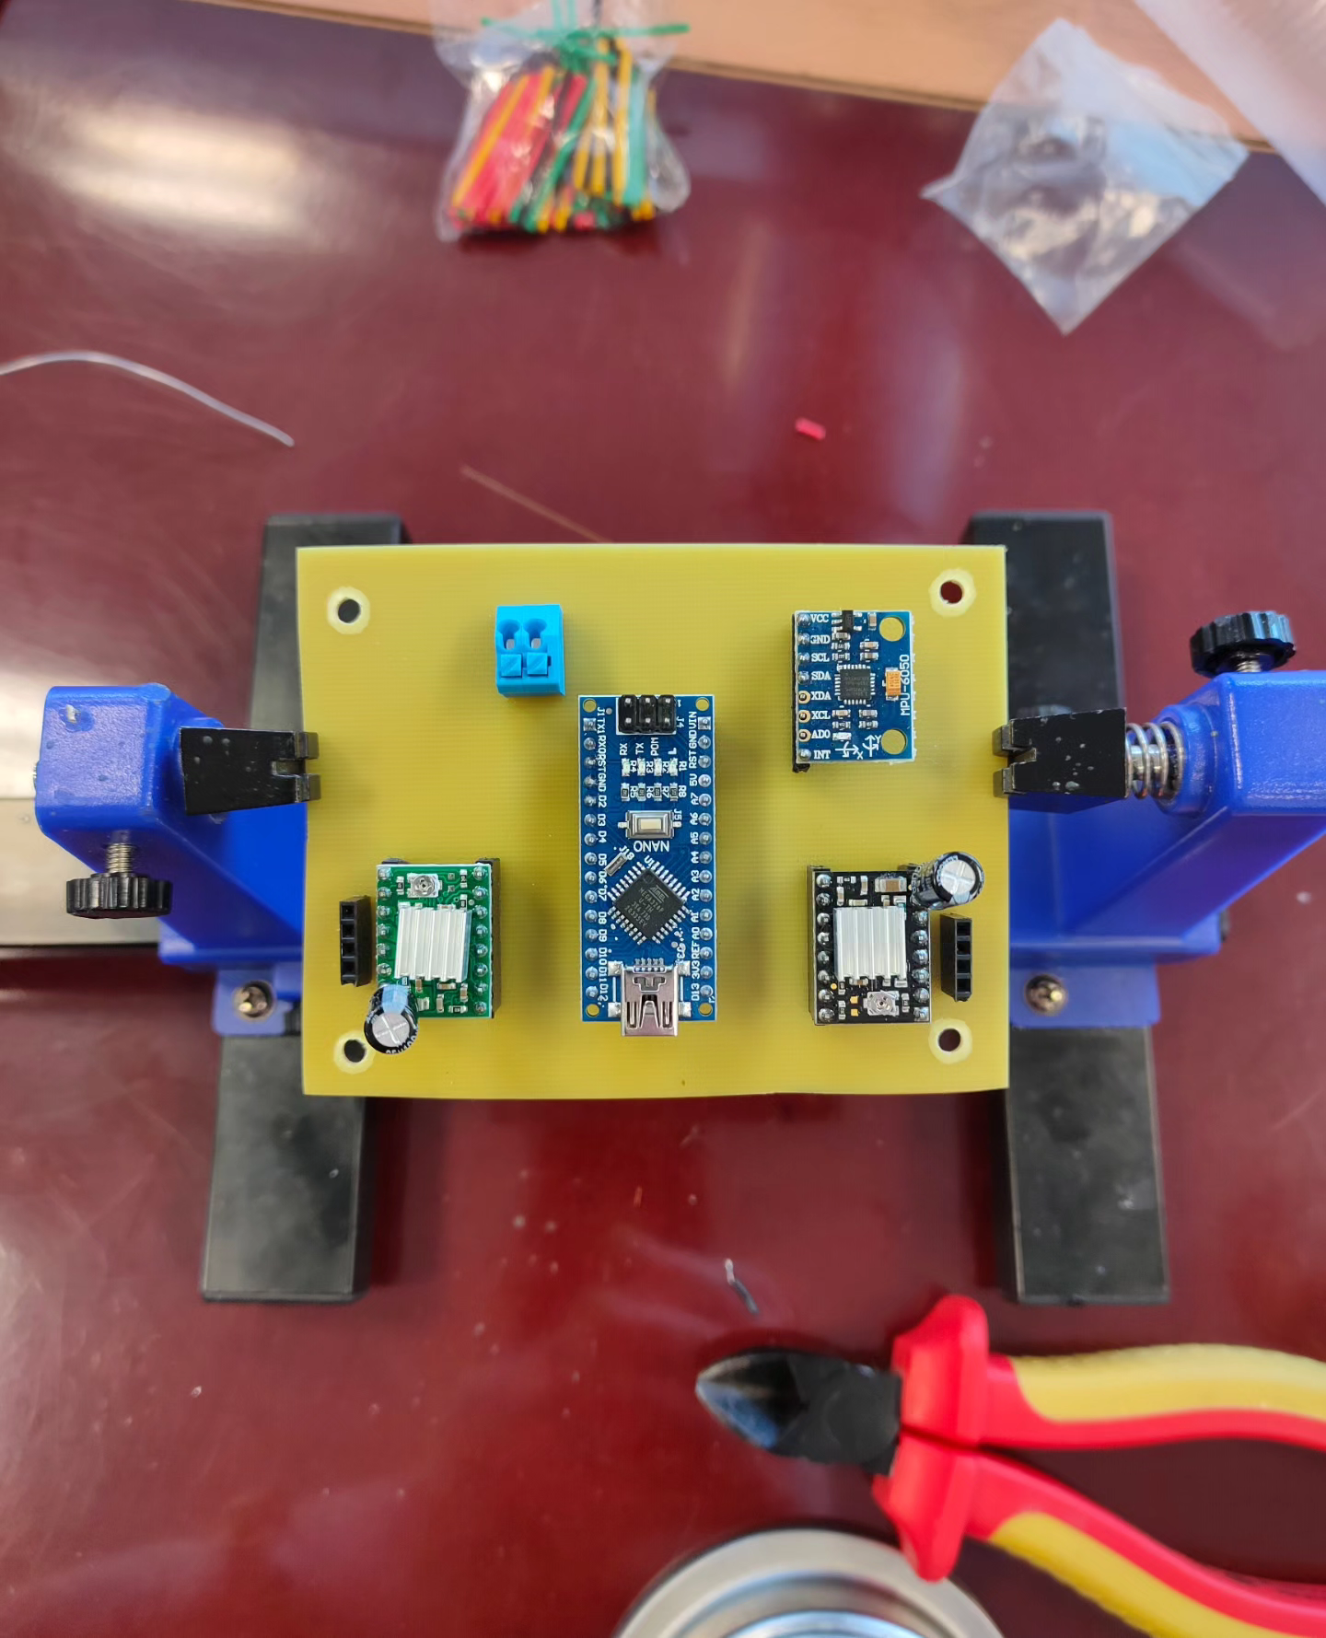
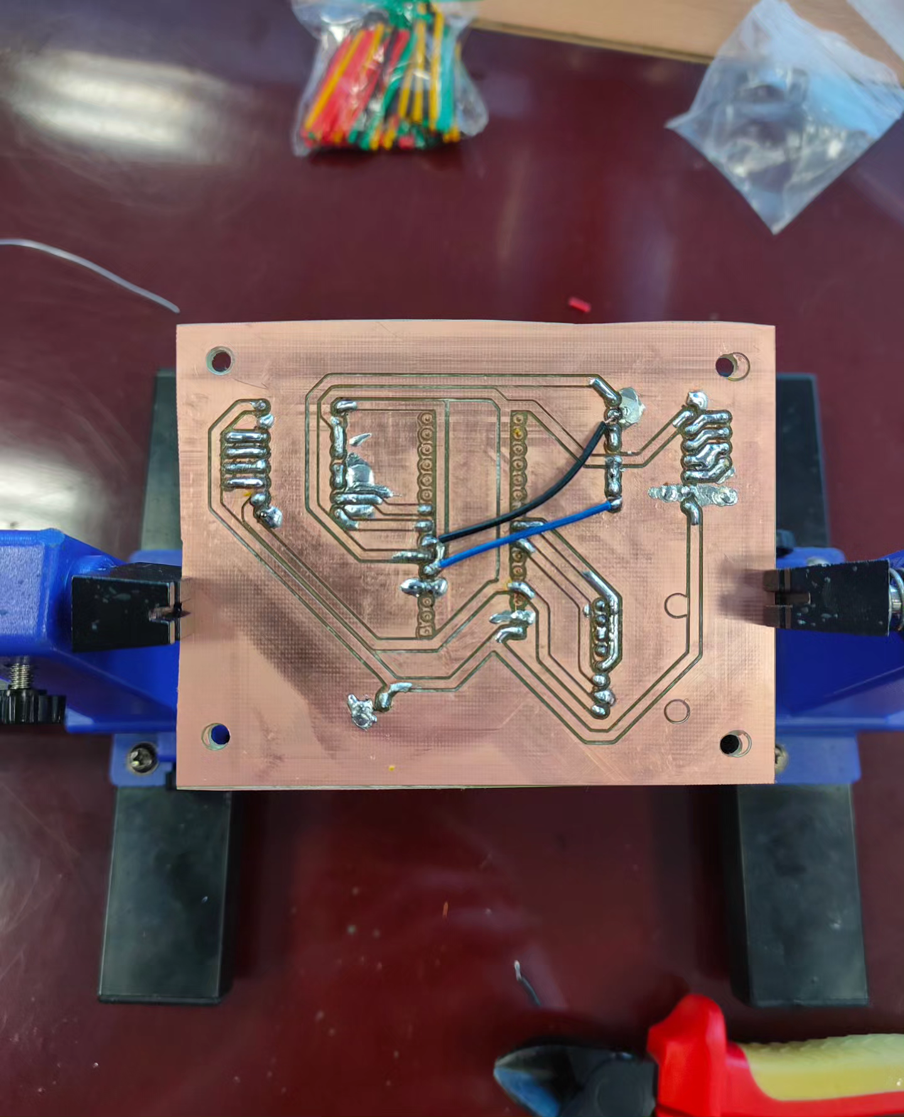
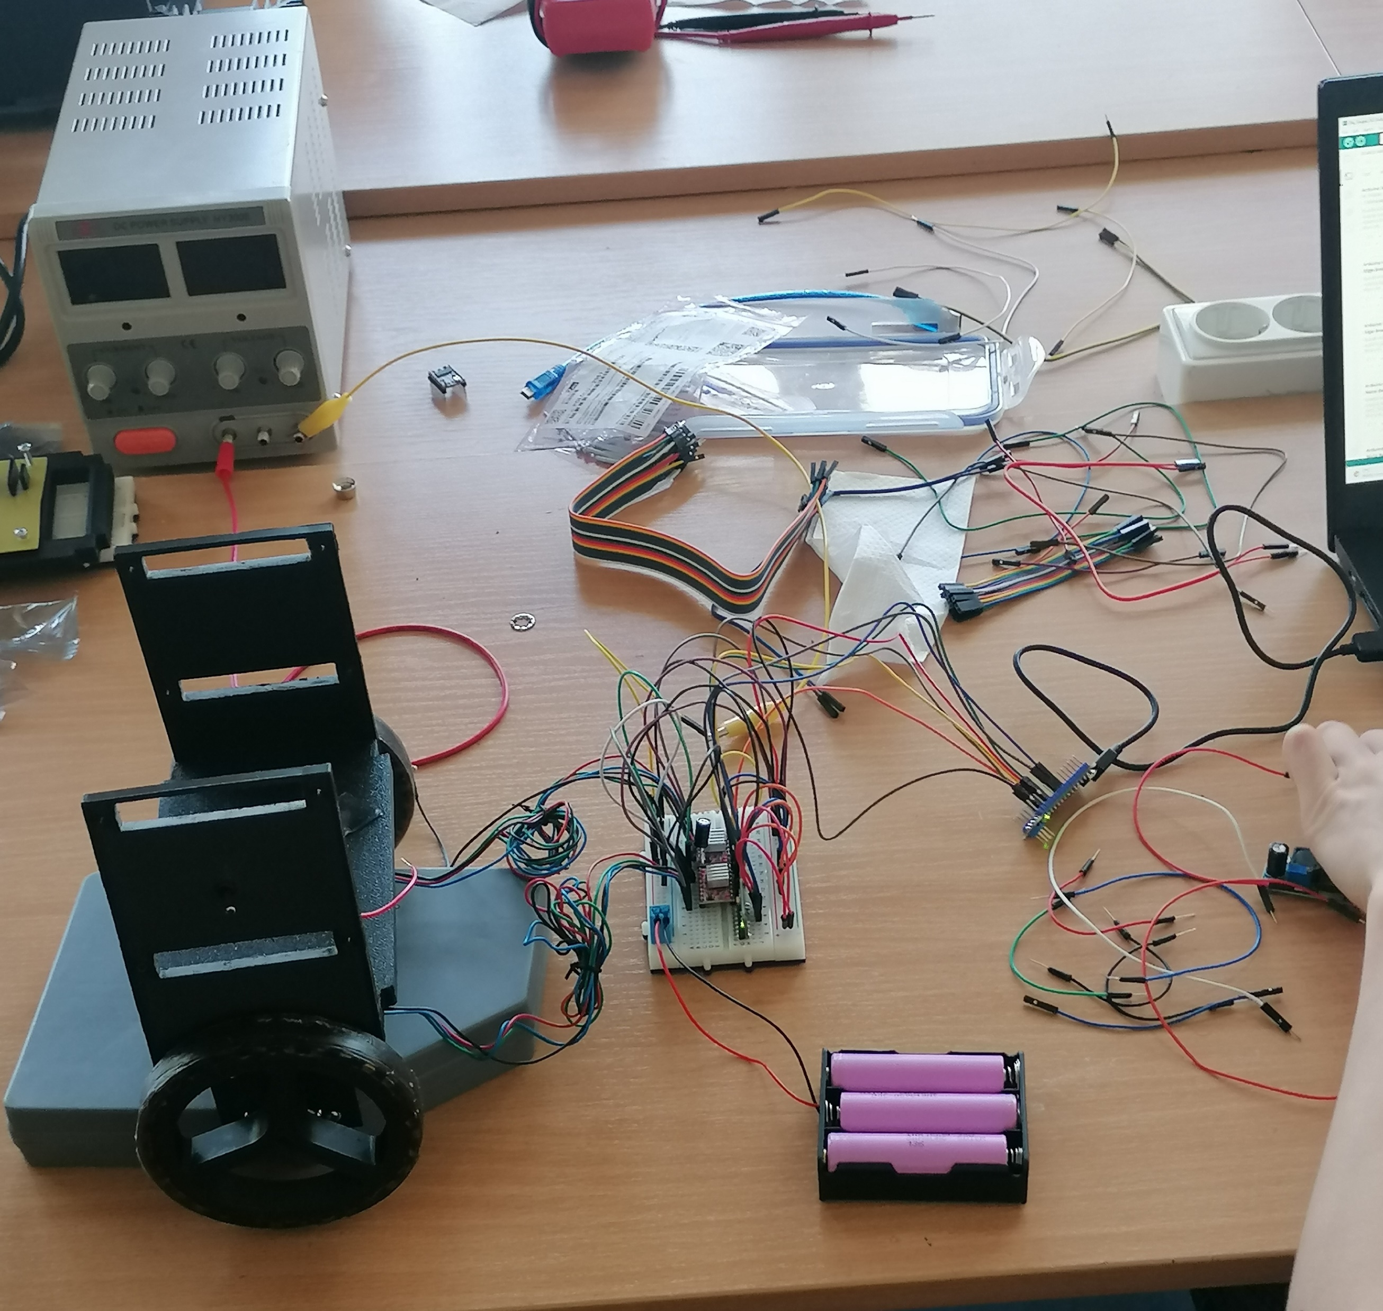

Slide 13
Results
Overall, the robot got assembled correctly with all the parts working.Unfortunately, we couldn’t put the program to work, so the robot to function.

Slide 14
Thank you for attention!

